Slide 1
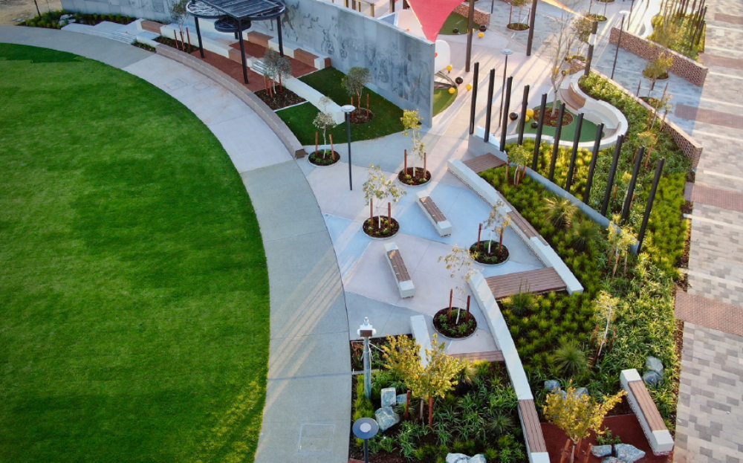
Bullsbrook Infrastructure Future
City of Swan
Asset Management
12th March 2025
Notes:
Thanks for coming
Refreshments available – help yourself
Toilets – direction

Slide 2
Agenda
Wednesday March 12, 2025
6:00pm Welcome
6:10pm Presentation
6:30pm Questions
6:45pm Feedback session
Notes:
Run through how the night will look
Firstly we will have our Facilities planner presenting on the consultation tonight
Then we will introduce Craig from Kingsford to run through their plans
There will be time for questions
And then we will finish with workshopping the feedback

Slide 3
Community Consultation
      October 9 - Information session and workshop for affected stakeholders
      November – December Community consultation
      December Christmas event – Feedback from community
      March 12 – Draft sketches presented to engaged community
      April – Engaged community updated with final plans via email

Slide 4
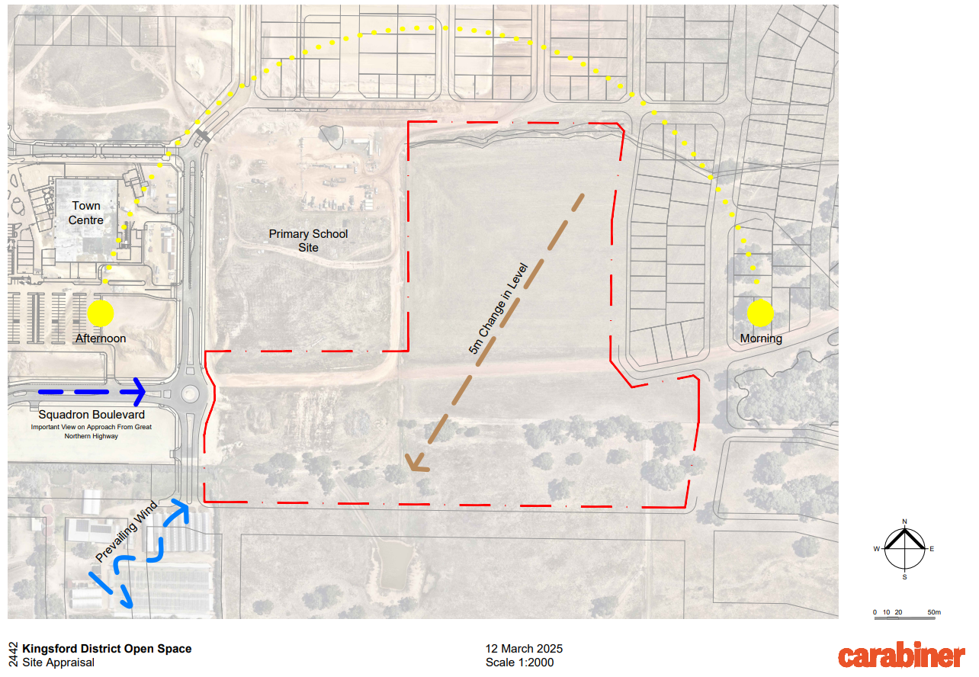
Kingsford District Open Space

Slide 5
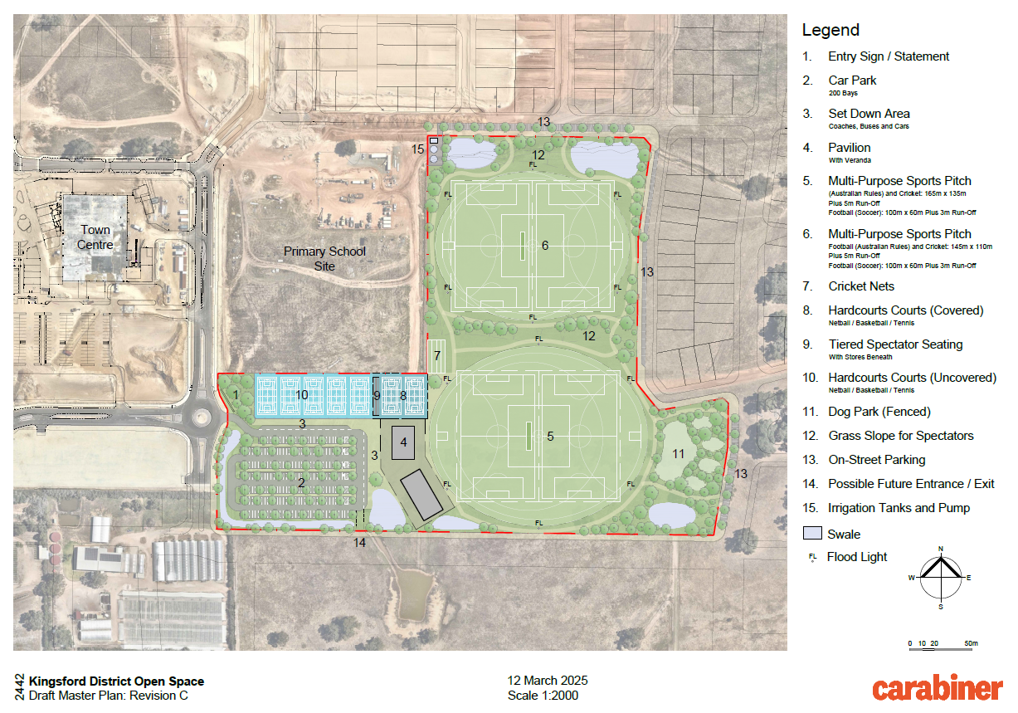
Kingsford District Open Space

Slide 6
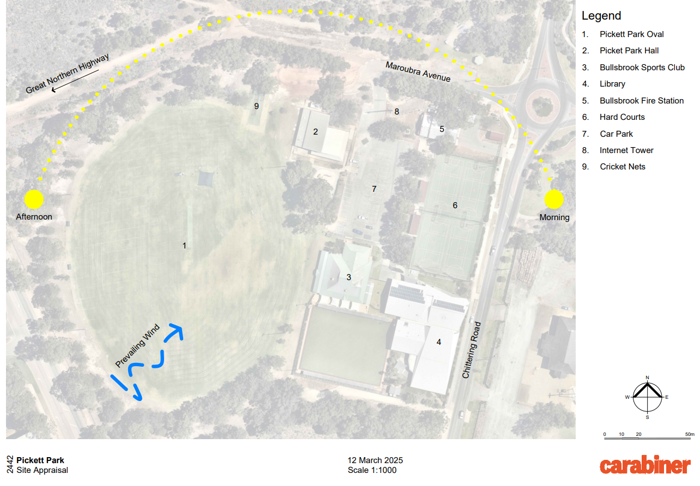
Pickett Park

Slide 7
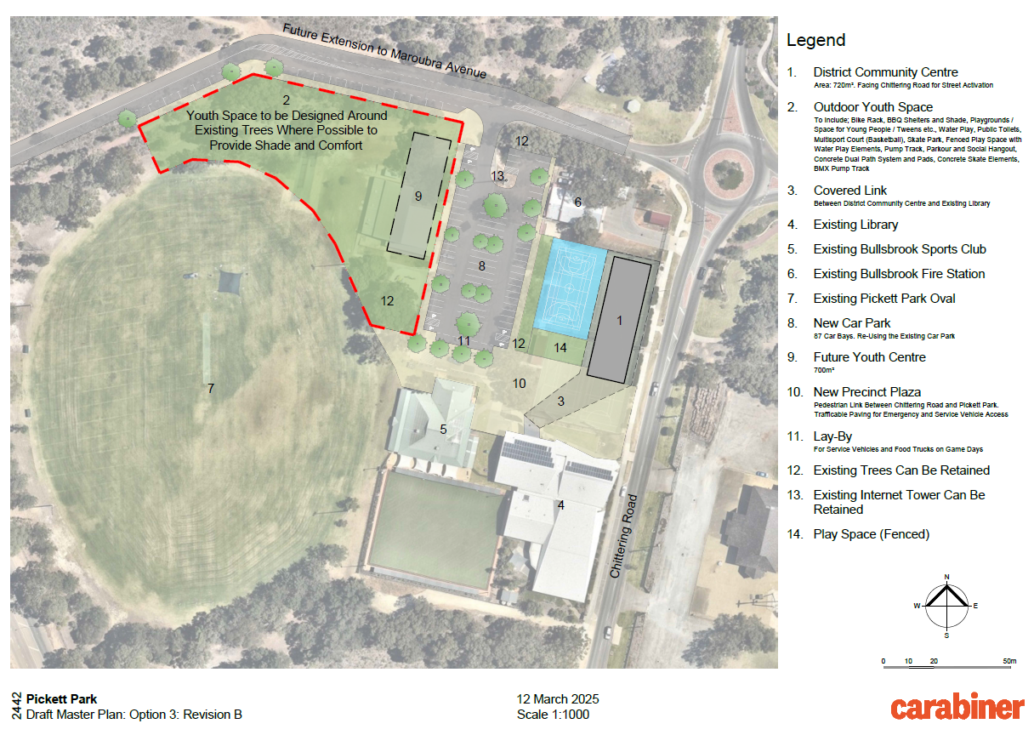
Pickett Park

Slide 8
Questions?

Slide 9
Provide your feedback
Visit the below link if you would like to formally provide your feedback later.
The survey will close in one week, at 5pm on March 19, 2025
www.swanengage.com/bullsbrookinfrastructure
Notes:
There is a link to a survey if you wish to provide additional comments after this session, otherwise you are welcome to email us.
If everyone can please get some textas and note down any comments you have, we have some prompting questions on the page to get you thinking
We will be walking around the room for the next half an hour if you have any questions please ask.

Slide 10
Thank you
Notes:
Please feel free to take the presentations home and provide further feedback via the link for the next week
Please leave your completed worksheets on the table for us to collect.
Thanks again for your time tonight

